Slide 1





Bike Share SCM Analysis
Ensuring Timely and Efficient Bike Availability: Q1 2019 vs Q1 2020
Presented By:
Paul Kamande
Notes:
Welcome to the presentation on Divvy’s Supply Chain Management (SCM) analysis for Q1 2019 and Q1 2020. In this analysis, we will explore bike share trip data and identify challenges around bike availability and rebalancing strategies. This analysis aims to provide insights on SCM improvements, focusing on both customer satisfaction and revenue optimization. We'll also delve into various patterns, such as demand by hour, day, and month, and explore the impact of different rider types (members vs casual) on the system. My name is Paul Kamande.

Slide 2


Problem Statement
Divvy faces spatial and temporal imbalances in bike availability.
Stockouts during high-demand periods are common.
Idle inventory accumulates at stations with low demand.
Balancing inventory to optimize availability is a challenge.
Ensuring efficient SCM can prevent both stockouts and idle inventory.
Notes:
The problem statement focuses on the spatial and temporal imbalance in Divvy’s system. This issue causes frequent stockouts during peak demand periods and leads to excess bikes at certain stations during off-peak hours. Such imbalances in the distribution of bikes affect customer satisfaction and reduce the overall system efficiency. As part of this analysis, we will explore strategies to improve inventory management, ensure bikes are available where needed, and address the challenges of overstocking and understocking at different times.

Slide 3
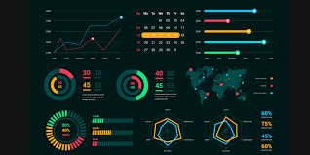

Data Overview
Data spans Q1 2019 and Q1 2020.
Data includes trip records, stations, and rider types.
Data sources: Divvy bike share system.
Variables include trip duration, station ID/name, and rider type.
Focus on 1 million+ records for robust analysis.
Notes:
This analysis uses data from Divvy’s bike-sharing service for Q1 2019 and Q1 2020. The dataset includes over 1 million records of bike share trips, station IDs and names, and rider types (e.g., members and casual riders). We use this data to identify key patterns in trip durations, demand fluctuations over time, and the relationship between station-specific demand and supply. The dataset also includes trip start and end times, which are essential for understanding temporal demand patterns. This will allow us to analyze the effectiveness of current SCM practices.

Slide 4

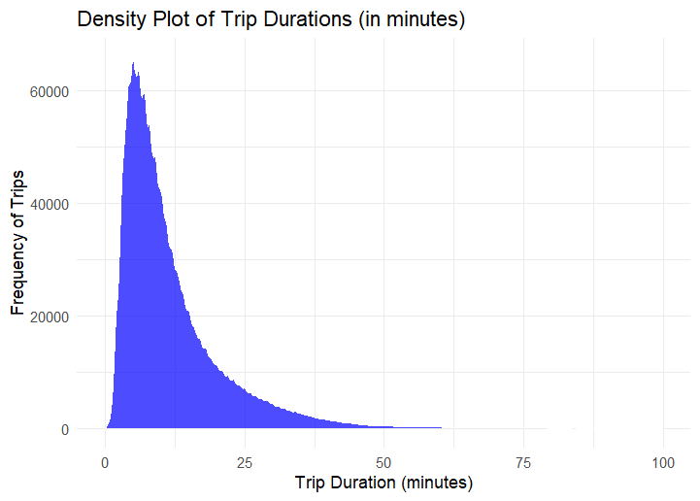

Trip Duration Insights
Majority of trips last between 5 and 20 minutes.
Short trip durations indicate a high turnover rate of bikes.
Short trips are more frequent than long trips.
Longer trips (>1 hour) are rare and considered outliers.
Efficient fleet management requires focusing on shorter trips.
Notes:
The analysis of trip durations reveals that the majority of bike trips last between 5 and 20 minutes. This indicates a high turnover rate of bikes, meaning that the bikes are used and returned quickly. Focusing on these short trips is essential for fleet management as they form the bulk of the operations. Longer trips, exceeding 1 hour, are rare and can be considered outliers, representing less common demand. Efficient fleet management for Divvy must prioritize short trip durations to improve bike availability and optimize the rebalancing process during peak hours.

Slide 5


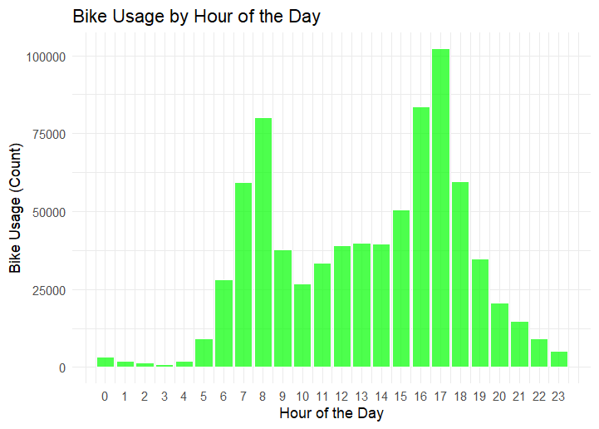
Hourly Demand Patterns
Peak demand occurs during morning and evening commutes.
Bike usage is highest between 7-9 AM and 4-6 PM.
Early morning (6-7 AM) sees moderate demand.
Off-peak demand occurs in the mid-day (11 AM - 2 PM).
Late-night hours show very low bike usage.
Notes:
Bike usage is strongly influenced by time of day, with clear peaks during the morning and evening commute hours. The highest demand occurs between 7-9 AM and 4-6 PM, aligning with typical commuter patterns. Moderate demand is seen in the early morning, around 6-7 AM, while mid-day (11 AM to 2 PM) sees a dip in usage. Late-night hours (after 10 PM) are characterized by very low usage, suggesting minimal demand during these hours. This information is crucial for understanding when to focus rebalancing efforts and optimize fleet distribution throughout the day.

Slide 6

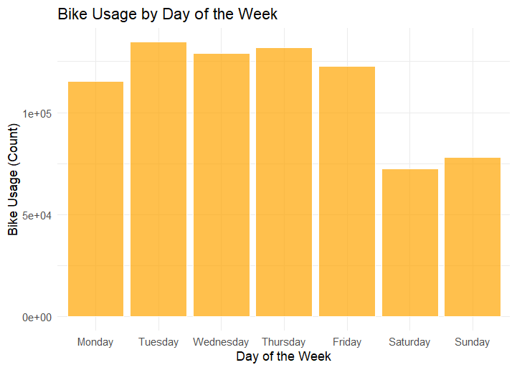




Weekday vs Weekend Demand
Weekdays show consistently higher demand than weekends.
Weekend usage drops significantly, especially on Sundays.
Weekday demand peaks during commute hours.
Weekends are more variable, with lower but occasional spikes.
Weekends are more variable, with lower but occasional spikes.
Notes:
A significant difference in bike usage exists between weekdays and weekends, with weekdays consistently showing higher demand. Weekends, particularly Sundays, have a marked drop in bike usage. On weekends, the demand is more variable, and occasional spikes in usage occur during events or special circumstances. Understanding this difference is key to rebalancing strategy, as most bikes should be redistributed to meet weekday demand, especially during peak commuting hours. Weekend demand can be handled with more flexible inventory distribution, ensuring that stations are adequately stocked without overloading bikes during low-usage periods.

Slide 7


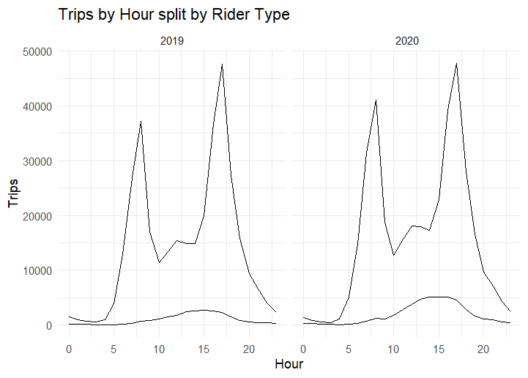

Member vs Casual Riders
Members account for more predictable demand patterns.
Casual riders contribute to more volatile demand.
Member usage peaks during work commute hours.
Casual riders tend to use bikes during weekends and leisure hours.
Understanding the differences helps in optimizing fleet distribution.
Notes:
Divvy's bike-sharing service sees distinct usage patterns between members and casual riders. Members, who are generally subscription-based, have more predictable demand, especially during work commute hours (7-9 AM, 4-6 PM). Casual riders, on the other hand, create more volatile demand patterns, often peaking during weekends or leisure times. To optimize fleet distribution, SCM strategies must take these differences into account. Fleet adjustments based on rider type will help reduce rebalancing efforts while ensuring bikes are available when and where they are most needed.

Slide 8
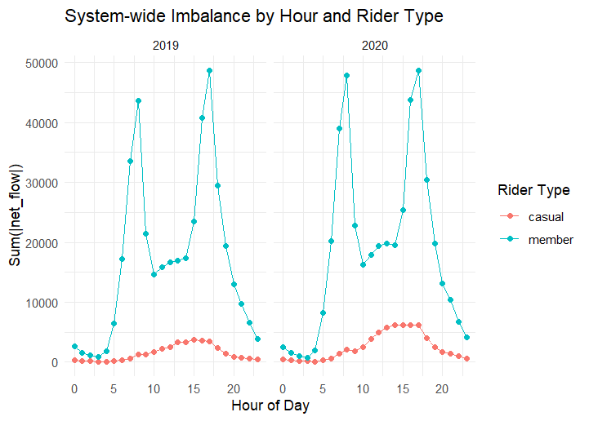







System-wide Imbalance
Imbalance occurs when demand exceeds bike availability.
Imbalance occurs when demand exceeds bike availability.
Off-peak hours have less imbalance, requiring less action.
System-wide imbalance can lead to stockouts or idle bikes.
Understanding imbalance is crucial for effective rebalancing.
Notes:
System-wide imbalance occurs when there’s a mismatch between bike demand and availability at specific stations. During peak commute hours, rebalancing pressure increases significantly, leading to either stockouts at high-demand stations or idle bikes at others. During off-peak hours, there is less imbalance, but some level of rebalancing is still needed to ensure bikes are evenly distributed. By identifying the times and locations where imbalance is highest, Divvy can optimize its rebalancing efforts and reduce both stockouts and idle bikes, ultimately improving the customer experience and revenue.

Slide 9

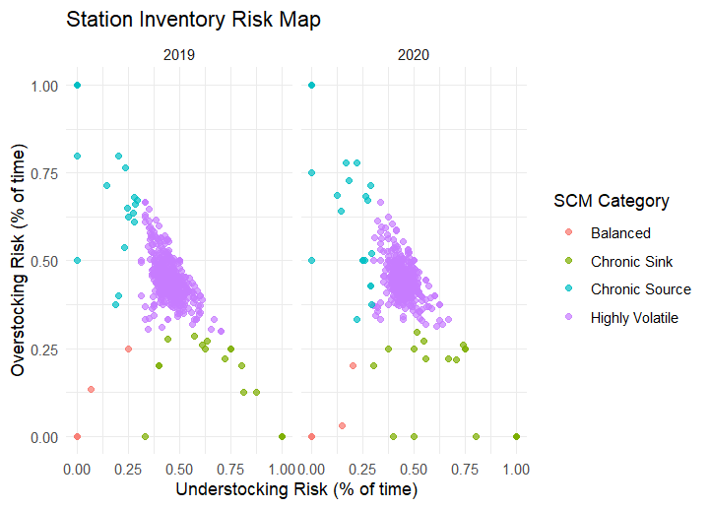


Station Risk Mapping
Certain stations contribute disproportionately to system imbalance.
High-risk stations need frequent rebalancing.
Risk mapping helps identify areas of concern.
Chronic sinks and sources require targeted intervention.
Identifying high-risk stations improves fleet management.
Notes:
Risk mapping identifies which stations are most responsible for imbalance, categorizing them as either sources (stations with excess bikes) or sinks (stations with high demand and insufficient bikes). These stations need to be monitored closely and frequently rebalanced to ensure bikes are available where needed most. High-risk stations, whether sources or sinks, should be the focal points of rebalancing efforts. With this targeted approach, Divvy can avoid unnecessary fleet movements and better manage inventory across the entire network, reducing both understocking and overstocking issues.

Slide 10

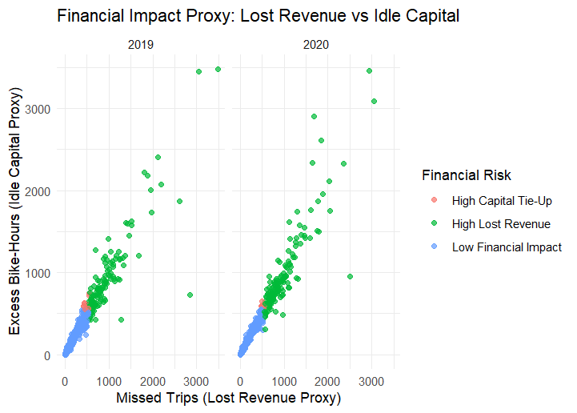


Financial Impact Proxies
Missed trips represent lost revenue due to stockouts.
Idle bike hours represent capital tied up in excess bikes.
Identifying financial impacts helps prioritize SCM interventions.
High-risk stations contribute to both lost revenue and idle capital.
Financial impact proxies guide decision-making on rebalancing.
Notes:
The financial impact of SCM inefficiencies can be measured through two proxies: missed trips and idle bike hours. Missed trips represent lost revenue when demand exceeds bike availability, while idle bike hours indicate excess inventory that ties up capital. By identifying the stations and times where these issues occur, Divvy can prioritize interventions at high-risk stations, optimizing fleet distribution and reducing financial losses. This approach allows for more effective resource allocation and ensures that financial constraints are minimized while meeting customer demand.

Slide 11

SCM Recommendations
Prioritize rebalancing during peak demand times (commute hours).
Focus on chronic sink stations to prevent stockouts.
Adjust fleet distribution to handle casual rider variability.
Invest in predictive models for demand forecasting.
Optimize fleet size based on demand patterns and risk mapping.
Notes:
Based on the analysis, we recommend that Divvy prioritize rebalancing during peak demand times, particularly in the morning and evening commute hours. Chronic sink stations, which are prone to stockouts, should receive more attention, ensuring bikes are available when demand peaks. Additionally, understanding the variability in demand from casual riders allows for more flexible fleet distribution during weekends. Finally, investing in predictive models and optimizing fleet size based on both demand patterns and risk mapping will allow Divvy to enhance overall efficiency, reduce operational costs, and increase customer satisfaction.

Slide 12
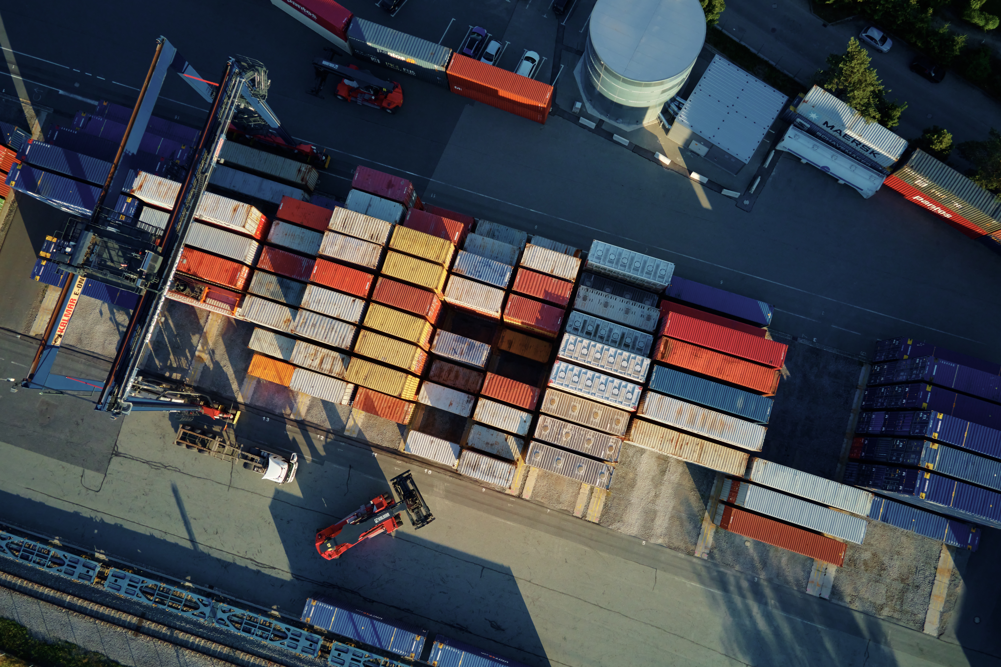





Thank You
So Much
We are happy to discuss any aspect of the presentation in more detail.
Do you have any questions?

